Slide 1



Optimizing Sales & Marketing Strategies for Sustainable Growth at Ajay Prasad Jewellers
BDM CAPSTONE PROJECT
Submitted by:
DIPSHIKHA
23F2001481

Slide 2
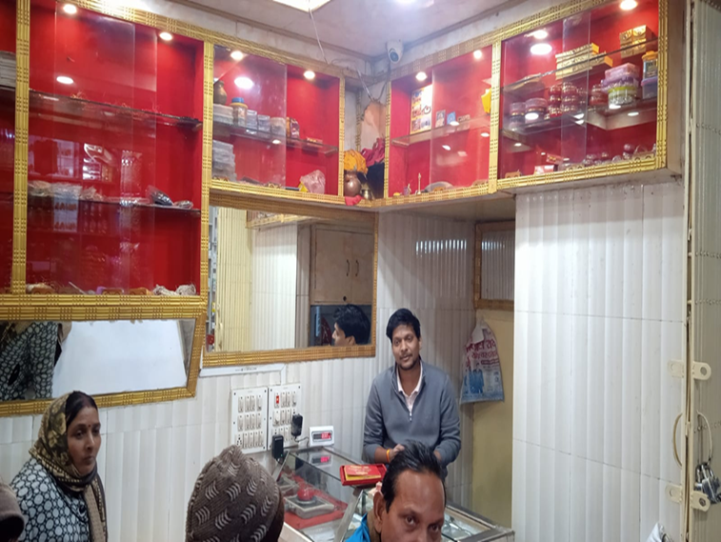

Content
Business Image: Ajay Prasad Jewellers
Business Image: Ajay Prasad Jewellers
Business Introduction
Problem Statement
Content
Results and Findings
SWOT Analysis
Recommendations for the business
Business Introduction
Problem Statement
Conclusion
Results and Findings
SWOT Analysis
Recommendations for the business

Slide 3

Business Introduction
Established in 2018 by Mr. Ajay Prasad
Located in Sbj Market, Jehanabad, Bihar
Operates as a retail jewellery store
Known for affordable pricing and personalized service
Specializes in high-quality gold and silver ornaments
Serves a loyal local customer base
Focus on customer satisfaction and ethical business practices
Trusted and reputable name in the regional jewellery market

Slide 4
Problem Statement
1 Low Sales & Revenue: Ajay Prasad Jewellers struggles with inconsistent sales and revenue due to low brand visibility and weak customer acquisition, limiting overall growth.
2 Customer Retention & Competition: High competition from large brands and local jewellers makes retaining customers challenging, leading to reduced profitability and difficulty in market differentiation.
3 Inventory & Pricing Challenges: Fluctuating gold prices and shifting customer preferences result in inventory mismanagement and pricing difficulties, increasing financial risks and lowering profit margins.

Slide 5
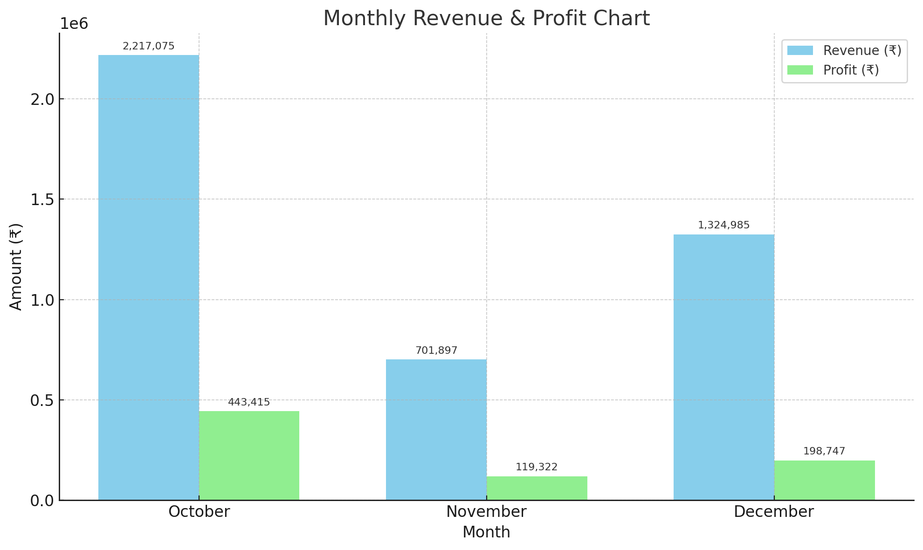
Results and Findings
Revenue vs. Profit Comparison: Each month displays two bars—one for revenue and one for profit—allowing a direct comparison of earnings versus actual profit.
Highest Performance in October: October shows the highest revenue (₹2.2M) and profit (₹443K), indicating strong business performance during this month.
Lowest Revenue and Profit in November: November records the lowest figures, with revenue dropping to ₹701K and profit to ₹119K, suggesting a potential dip in sales or seasonal slowdown
Moderate Recovery in December: Revenue and profit both rise in December to ₹1.32M and ₹198K respectively, reflecting a partial recovery from November.
Profit Trends Align with Revenue: While the profit percentage varies slightly, the general trend is that profit increases or decreases proportionally with revenue.

Slide 6
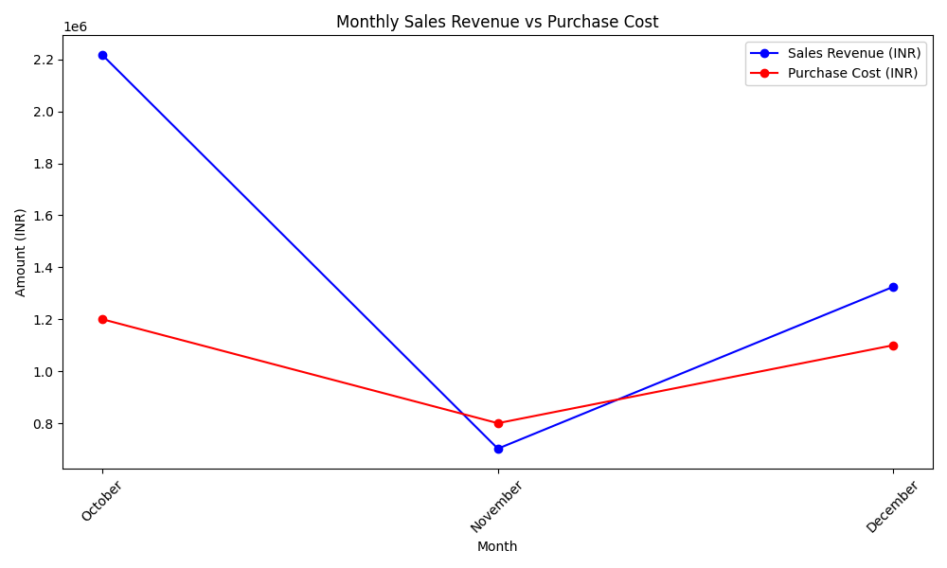
🔹 1. Strong Profitability in October
Sales Revenue (~₹2.2M) was much higher than Purchase Cost (~₹1.2M).
Indicates excellent sales performance during the festive season.
🔹 2. Loss in November
Sales Revenue (~₹701K) dropped below Purchase Cost (~₹800K).
Signifies financial loss due to poor demand forecasting post-festival.
🔹 3. Partial Recovery in December
Sales Revenue (~₹1.32M) rebounded, but the Purchase Cost (~₹1.1M) remained high.
Shows improved demand, but margins remained tight.
🔹 4. Need for Inventory and Pricing Optimization
Fluctuations highlight the need for dynamic inventory planning and real-time pricing adjustments.
Essential to balance purchase decisions with market demand.

Slide 7
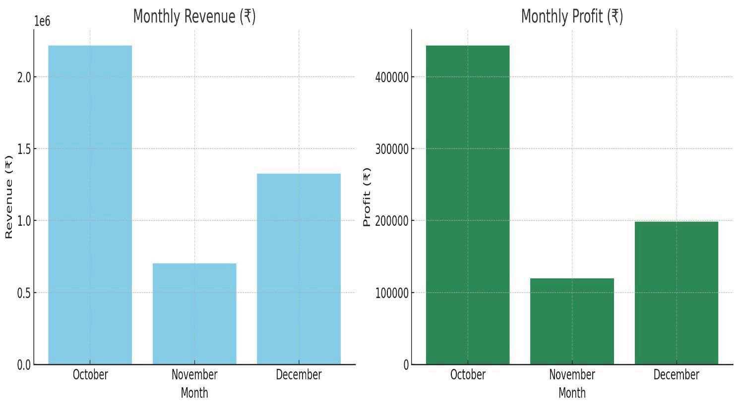
🔹 1. October Peak Performance
Highest Revenue (~₹2.2M) and highest Profit (~₹4.4L) achieved due to strong festive season sales.
🔹 2. November Dip and Low Profitability
Significant drop in Revenue (~₹700K) and Profit (~₹1.2L) in November, reflecting weak post-festival demand and poor sales planning.
🔹 3. December Recovery Phase
Revenue (~₹1.32M) and Profit (~₹2L) improved compared to November, indicating partial business recovery through better inventory alignment and customer engagement.

Slide 8
📊 Results and Insights
🔵 Results:
October 2024:
Highest Sales Revenue (~₹2.2 million)
Strong Profit (~₹4.4 lakh) fueled by festive season demand.
November 2024:
Sharp decline in Revenue ((₹1.2 lakh) due to reduced customer traffic and overstocking.
December 2024:
Partial recovery with Revenue (₹2 lakh) due to better marketing and inventory management.
🔵 Insights:
Seasonal Dependence:
Business heavily reliant on festive season; off-season needs stronger promotional strategies.
Inventory-Pricing Mismatch:
Overstocking and static pricing in November reduced margins; highlights the need for dynamic stock and price management.
Recovery Potential:
December's improvement indicates that agile marketing, strategic inventory planning, and flexible pricing can stabilize performance throughout the year.

Slide 9
📊 SWOT Analysis
Positive
Positive
Negative
🟠 Weaknesses:
🔵 Strengths:
Strong local reputation
Affordable and customer-centric pricing
Personalized, flexible service
Quick decision-making & adaptabil
Limited brand visibility beyond Jenanabad
Small inventory size leading to stockouts
Heavy dependence on seasonal sale
No real-time dynamic pricing
THREAT
Internal
🟢 Opportunities:
🔴 Threats:
OPPORTUNITY
Expand via social media & online sales
Launch trendy lightweight jewellery
Partnering with local events, fairs
Use of analytics for better stock planning
Rising competition from major brands and online platforms
Volatility in gold and silver prices
Economic slowdowns affecting luxury buying
External

Slide 10
Recommendations
1.Optimize Inventory Management: Maintain an ideal stock level by analyzing fast- and slow-moving items. Reduce overstocking of low-demand designs and focus on high-turnover products to improve cash flow. 2.Enhance Purchase Planning: Use historical purchase data to negotiate better rates with suppliers during peak seasons and minimize unnecessary bulk buying during slow periods. 3.Improve Sales Strategy: Identify top-selling items and customer segments. Run targeted promotions and loyalty programs based on customer preferences and peak buying periods. 4.Digitize Records and Reporting: Shift to a structured digital system for real-time sales, inventory, and purchase tracking. This reduces errors and improves decision-making with better visibility. 5.Forecast with Data Insights: Use trend analysis to forecast demand, plan festive-season collections, and avoid last-minute stockouts or surplus.

Slide 11
Conclusion
In conclusion, Ajay Prasad Jewellers has strong potential but needs better planning and digital adoption to overcome its challenges. With proper planning, digital tools, and targeted marketing, the business can: 🔄 Stabilize sales throughout the year 📊 Improve profit margins 🚀 Achieve long-term, sustainable growth

Slide 12
THANK YOU

